Slide 1
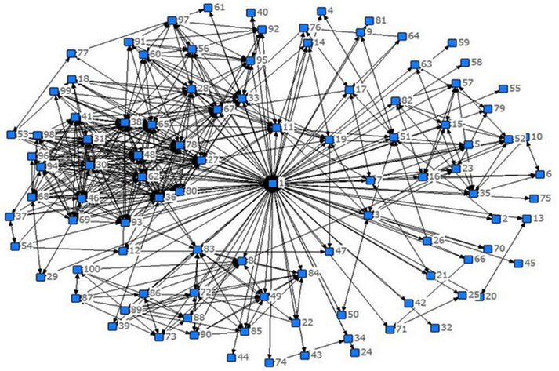
Capturing consumer perceptions, subconscious data & intent for accurate recommendations that can dramatically increase customer retention and profitability.
Clans
,
09202121

Slide 2
The Clans Recommender
Tested and validated a working, patent-pending recommendation system able to capture wine perception, and intent with an accuracy rate of 72-93% using 350,000 normalized third-party data records.
Proprietary Clans native data format expects consistently accurate recommendations of 90%+.
Because emotions and the subconscious are fundamental drivers of purchase decisions, Clans is vital for “metric-driven” products, as well as those of taste.
Property of Revolution Algorithms - Copyright 2021

Slide 3
This presentation is the graphic summary of series of articles (below) by Clans inventor Lewis Perdue Taken as a whole, this series demonstrates why even Netflix could not be the “Netflix of wine” without added capabilities. (Right-click hyperlinks to open)
Article #1: How A Netflix-Style Recommender Is Vital to Reversing Wine’s Market Marginalization
Article #2: Why solving the “Paradox of Choice” is a major reason Netflix’s recommender is worth $1 Bil/yr. And why wine fails at that.
Article #3: Reviews and 5-Star ratings are so useless for recommendations that Netflix ditched its prized $1-million algorithm.
Article #4: Wine wreck-commendations: Genes determine that no two people taste the same wine the same way.
Article #5: Netflix Added Big Data To Amp Up Recommendations. Why Wine Needs a Touch of That Too.
Article #6: The Path To Netflix-Quality Wine Recommendations Leads Through The Doors of Perception
Property of Revolution Algorithms - Copyright 2021

Slide 4
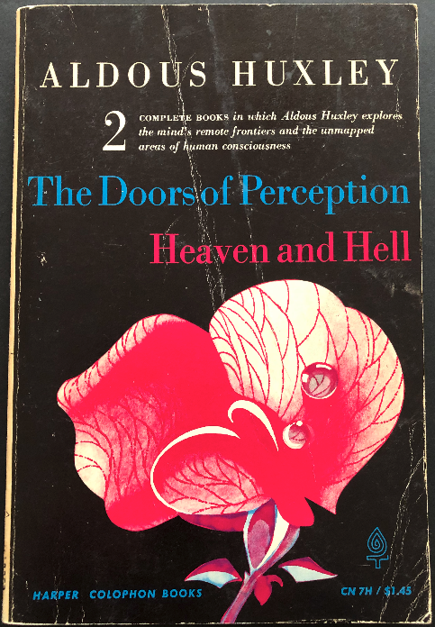
Until Clans is widely available, recommendations are a matter of …

Slide 5


Heaven
Hell

Slide 6
Heaven: A wine recommender based on the capture and analysis of individual perception, intent, and emotional preferences to retain customers and acquire new ones.
Hell:
Continue as usual.
Property of Revolution Algorithms - Copyright 2021

Slide 7
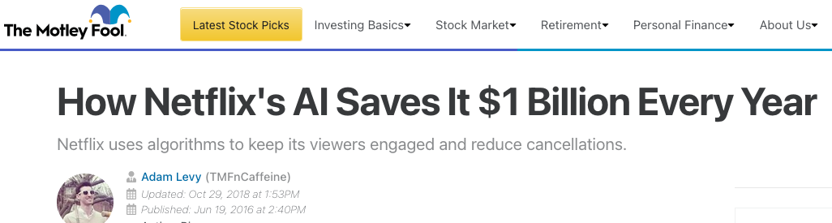
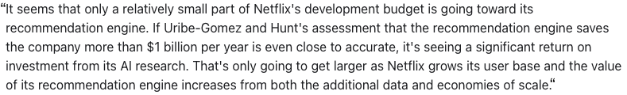
The Billion-Dollar Recommender
Property of Revolution Algorithms - Copyright 2021

Slide 8
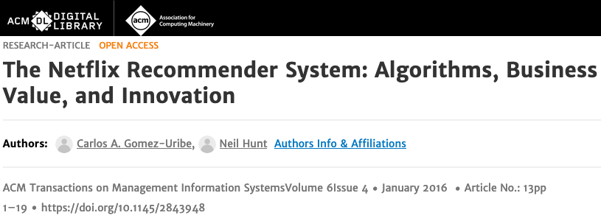
Why did Netflix kill stars and ratings? (To increase customer retention)
“Netflix has had star ratings for much of our history, but we’ve learned through over a year of testing that while we’ve used stars to help you personalize your suggestions, many of our members are confused about what they do….
“That’s because we’ve all gotten used to star ratings on e-commerce and review apps, where rating contributes to an overall average, and the star rating shown next to a restaurant or a pair of shoes is an average of all the reviewers. On those apps, being a reviewer can be fun and helpful to others, but the primary goal isn’t always to help you get better suggestions….
“There are much better ways of to help people find videos to watch than focusing only on those with a high predicted star rating.”
-- Gomez-Uribe & Neil Hunt eliminated stars and reviews when they designed and implemented Netflix’s new recommender.
Property of Revolution Algorithms - Copyright 2021

Slide 9
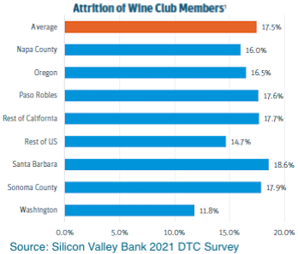
Netflix customer retention – Median: 93%
Wine
Winery Clubs – 82.5% annual retention
Retail Wine Clubs (Winc, First Leaf, etc.) - 65 to 75%
98% – “— The Netflix Recommender System: Algorithms, Business Value, and Innovation (written by two former top Netflix executives).
93% – Market Research Highlights Netflix’s Continued Dominance Of The SVOD Market
93% – Selerity: Netflix is successful thanks to big data and analytics.
91% – How Netflix Maintains a Low Churn Rate by Keeping Customers Engaged & Watching
Overall: Average customer retention rate by industry
Professional services: 84%
Media: 84%
Insurance: 83%
IT Services: 81%
Telecom: 78%
Banking: 75%
Retail: 63%
Property of Revolution Algorithms - Copyright 2021

Slide 10
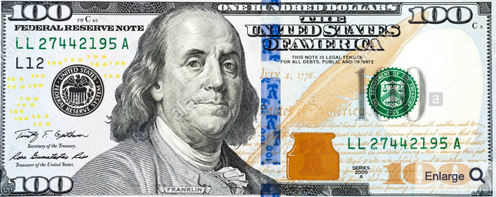
Customer retention is vital because…$$$$
New customer = 5 to 25 times more expensive than a retained customer -- Harvard Business Review
5% increase in retention rate = 25 to 95% profit boost -- Bain & Co
Regardless of retention rate, if the Consumer Lifetime Value of customers is less than the cost of acquiring those customers, then a business is headed toward the graveyard.
Property of Revolution Algorithms - Copyright 2021

Slide 11


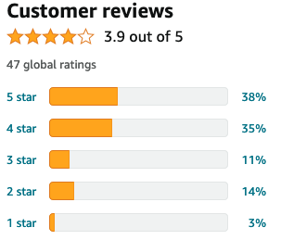
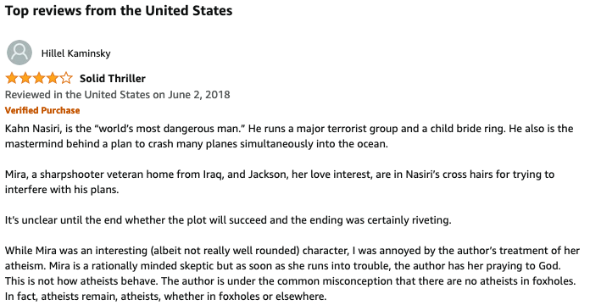

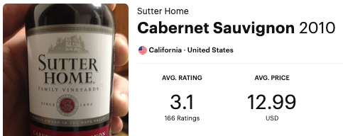
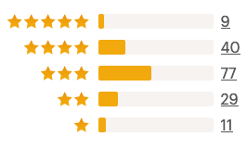
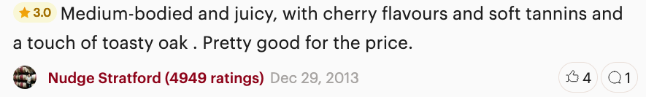

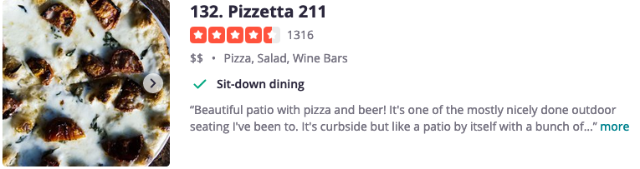





Netflix: “There are better ways than stars, ratings & reviews”
Yet, those are still the main methods:
Property of Revolution Algorithms - Copyright 2021

Slide 12
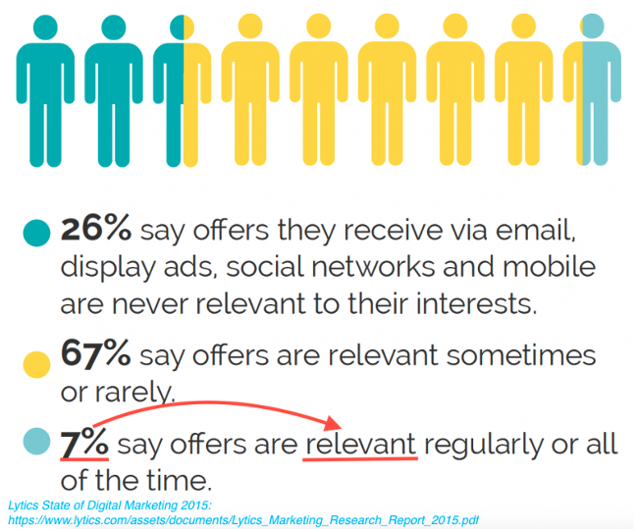
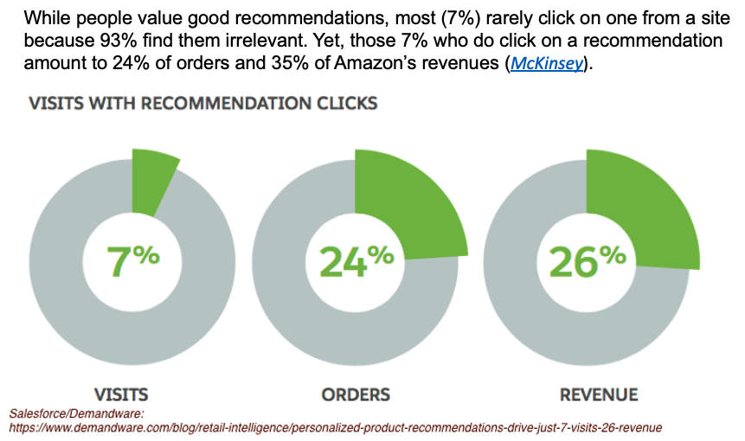
People hate recommendations based on ratings and reviews
As lousy as Amazon’s recommendations are, and as rarely as people click on them, those produce 35% of its revenues
Property of Revolution Algorithms - Copyright 2021

Slide 13
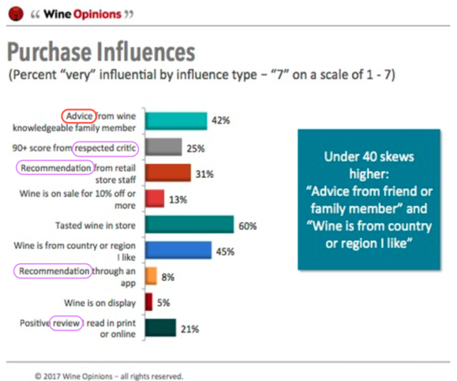
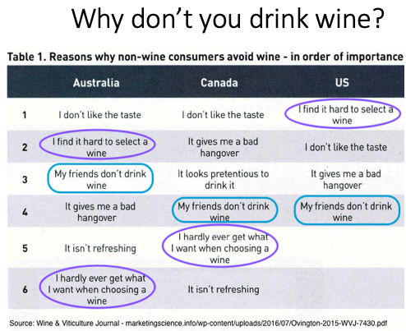
Wine recommendations fare even worse (With dramatic consequences)
Property of Revolution Algorithms - Copyright 2021

Slide 14
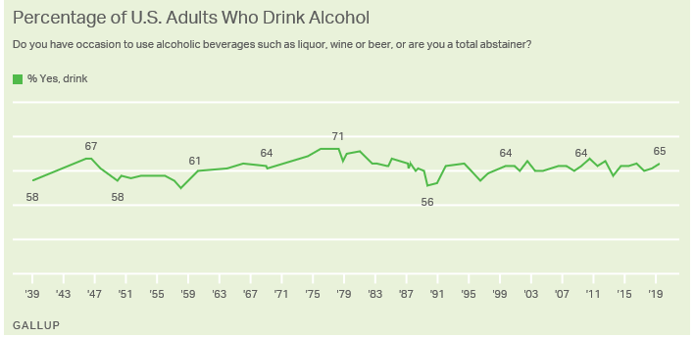
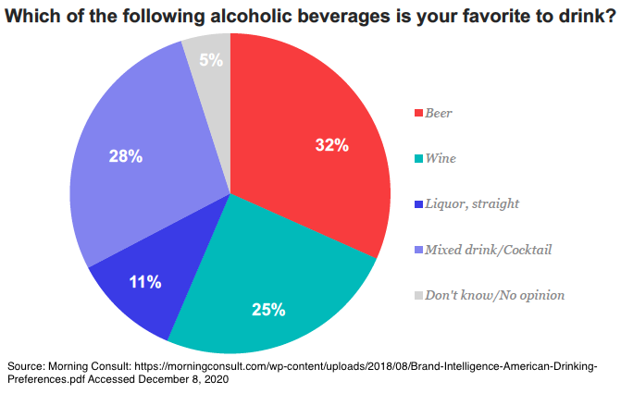
Little wonder wine is America’s most marginalized AlcBev
Of the 65% of Americans who consume alcohol …
...Only 25% prefer wine
Property of Revolution Algorithms - Copyright 2021

Slide 15
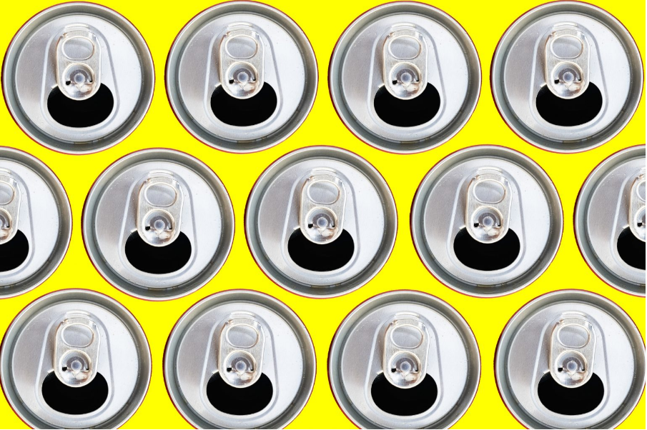
Ready-to-drink category will soon overtake wine in the US
Many factors marginalizing wine
Source: IWSR Drinks Market Analysis 06/07/2021
Property of Revolution Algorithms - Copyright 2021

Slide 16
Why have the days of stars and reviews long passed?
According to a published paper by the winners of the Netflix Prize:
User baseline ratings for the same movie change over time, a phenomenon known as “temporal effects.
Also: “a user who tended to rate an average movie ‘4 stars.’ may now rate such a movie ‘3 stars.’ …. Such effects can stem from many reasons. For example, it is related to a natural drift in a user’s rating scale, to the fact that ratings are given in relevance to other ratings that were given recently.
“[T]he effective user bias on a day can be significantly different than the user bias on the day earlier or the day after. [This] stems from the fact that users are usually associated with only a handful of ratings….”
“User preferences – users change their preferences over time. For example, a fan of the “psychological thrillers” genre may become a fan of “crime dramas” a year later. Similarly, humans change their perception on certain actors and directors.”
Property of Revolution Algorithms - Copyright 2021

Slide 17
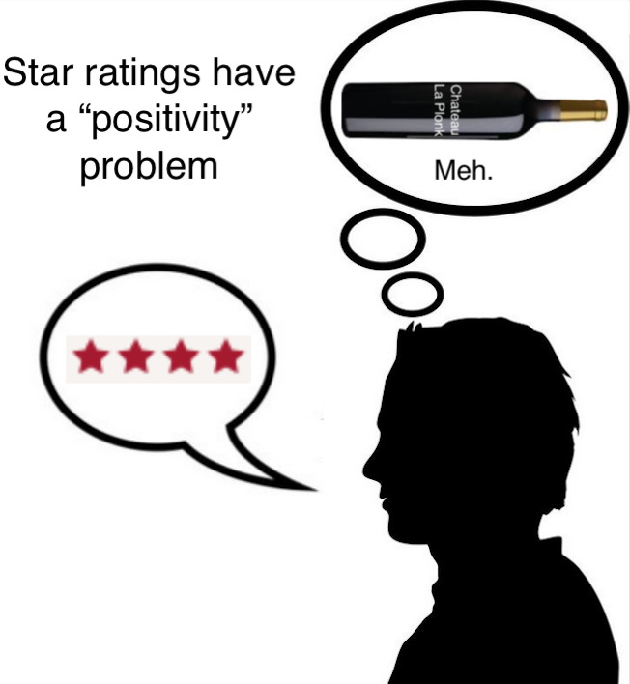
When “excellent” actually means “just okay”
Do five-star ratings systems have a ‘positivity’ (grade inflation) problem? https://www.retailwire.com/discussion/do-five-star-ratings-systems-have-a-positivity-problem/
'Emotional' reviews Answering NPR: Why 5-Star Rating Systems Don’t Work https://customerthink.com/answering-npr-why-5-star-rating-systems-dont-work/
Here's what's behind all those 5 star ratings https://www.nbcnews.com/better/business/does-five-star-online-review-really-mean-product-good-ncna870901
Property of Revolution Algorithms - Copyright 2021

Slide 18
Data Shows Stars Have Positivity/Grade Inflation Issues
Source: -- Nature Human Behaviour (Article), Published: 08 April 2021, Mass-scale emotionality reveals human behaviour and marketplace success, Matthew D. Rocklage, Derek D. Rucker & Loran F. Nordgren
“Star reviews are overwhelmingly positive⁵.
“On Amazon.com, for example, the average star rating is approximately 4.2 out of 5, with well over half of the reviews being 5-star ratings^{6,7}.
“Nearly half of all Yelp reviews are 5-star ratings⁸, and recent research indicates that nearly 90% of Uber ratings may be 5 stars⁹.
“A visual representation of most online ratings reveals a J-shaped distribution, with many 4- and 5-star ratings, a few 1-star ratings and few ratings in between⁵.
“The degree of overwhelming positivity suggests that individuals are often confronted with choosing between numerous items with similar star ratings, especially given that people will not even consider options that garner less than a 3-star rating.”
Property of Revolution Algorithms - Copyright 2021

Slide 19
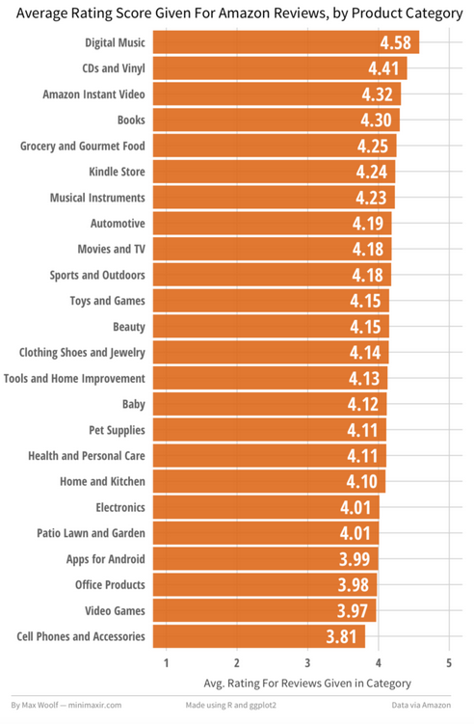
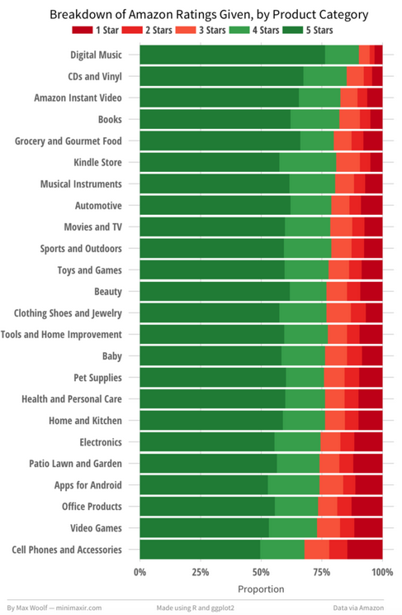
80 Million Amazon Product Reviews prove star ratings suck
Charts by Max Wolff. Right click hyperlink to visit his site.

Slide 20
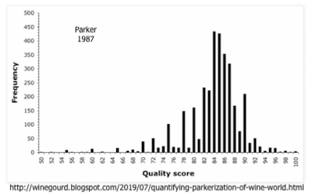
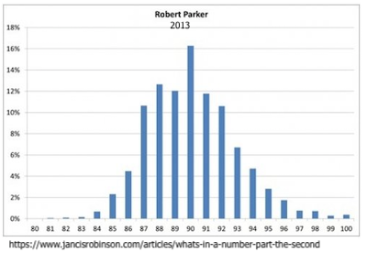
The 100-Point Scale Also Has a “Grade Inflation Problem
Not as much research has been conducted on the 100-point scale as with with stars. The best available comes from scientist/biostatistician David Morrison who writes regularly about wine & data in his Wine Gourd blog. The information below is excerpted from one of his posts (Parker 1987) which also relies on an article by Alex Hunt.
The absence of ratings of 80 and below in the 2013 chart, shows a significant inflationary/grade inflation shift. This phenomenon is also anecdotally in wine publication and and online reviews.

Slide 21
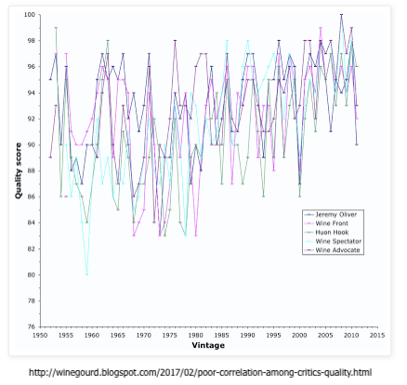
100-Point Scores Are Unreliably Inconsistent … Even Among Experts
Chart and text below courtesy of The Wine Gourd: “Poor correlation among critics' quality scores”
“If we take the vintages from 1952 to 2011 inclusive, then there are five commentators whose quality scores we can directly compare across these 60 vintages: Jeremy Oliver, Huon Hooke, and the Wine Front, all from Australia, and the Wine Spectator magazine and the Wine Advocate newsletter, both from the USA. Almost all of the critics discussed in this blog post use a 100-point quality scale. “This first graph illustrates these five sets of scores.”
“If this looks like a mess to you, then it is because this is a mess. There is clearly very little consensus among these scores, regarding which vintages are the better ones and which are not.”

Slide 22
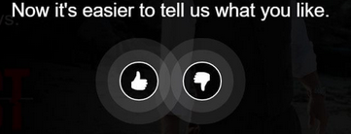
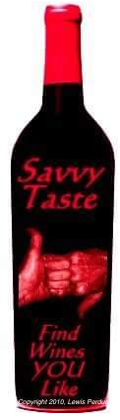
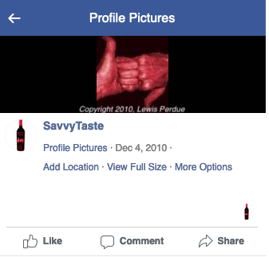
Netflix bails on stars and reviews in 2015 & goes thumbs up or down ….
This binary method was first applied to wine 5 years previously - in 2010 - by Clans Founder Lewis Perdue in his SavvyTaste Facebook App
More at: Reviews and 5-Star ratings are so useless for recommendations that Netflix tossed its prized $1-million algorithm.
Property of Revolution Algorithms - Copyright 2021

Slide 23
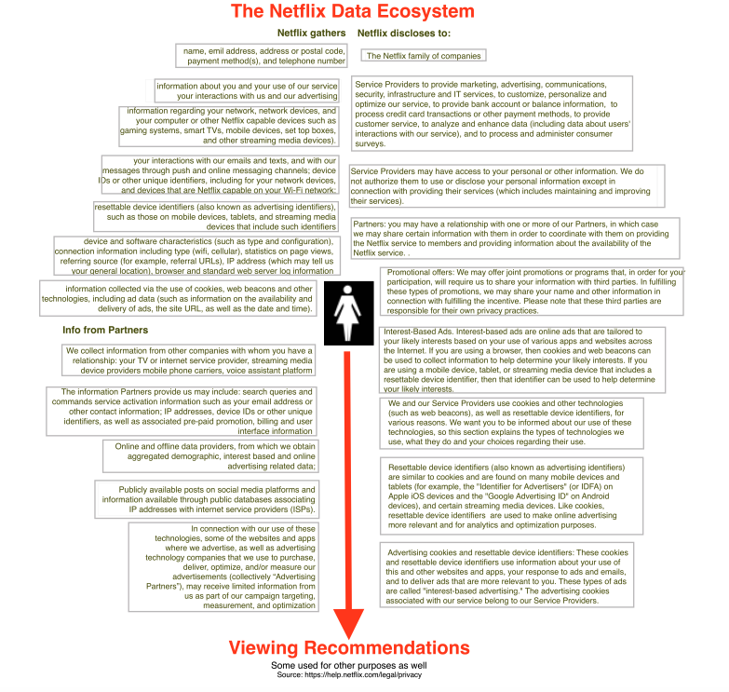
Netflix goes big on collecting personal data to increase recommendation accuracy
Now snared in legal, regulatory debate over privacy issues. Fails to address perception and emotion
More background at: “Netflix Amped Up Recommendations with its own Big Data. What that means for wine.“
Property of Revolution Algorithms - Copyright 2021

Slide 24
“[H]umans are surprisingly bad at choosing between many options, quickly getting overwhelmed and choosing ‘none of the above’ or making poor choices” — Carlos Gomez-Uribe, Netflix VP of product innovation & Chief Product Officer Neil Hunt.
That’s why Netflix winnows its video catalog down to a small number of titles, customized for each user
Netflix: 197 million users, thousands of choices
U.S. Users – 197 million (60% of the population)
Product Inventory – 5,879 video streams
Customers Per Product: 33,509
Wine has approximately 28 times more products but only about 1/8 the number of people to work with.
U.S. Customers – 37.3 million (11% of the population)
Wine: U.S, Product Inventory: 160,000+
Wine, U.S. Customers Per Product: 249
For more details, please see: “Why solving the ‘Paradox of Choice’ is a major reason Netflix’s recommender is worth $1 Bil/yr. And why wine fails at that.”
Property of Revolution Algorithms - Copyright 2021

Slide 25
Why wine’s harder to recommend than movies
Wine ages and is subject to bottle variation.
The ”same” wine will change from vintage to vintage.
Genetics prove that no two people taste the same wine the same way.
The human brain processes sight and sound very differently than smell and taste.
Much of smell and taste perception involves subconscious signals that are difficult – and frequently impossible -- to describe.
Property of Revolution Algorithms - Copyright 2021

Slide 26
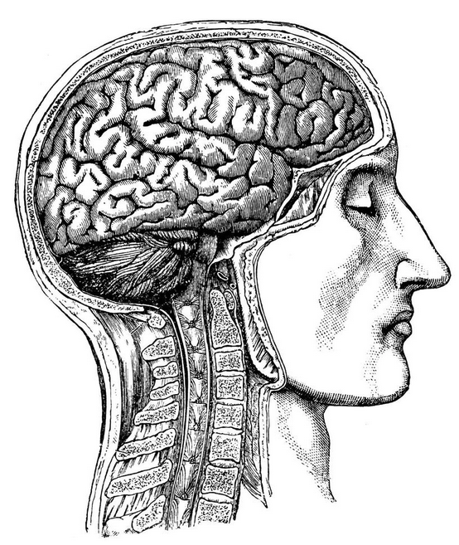
Understanding the importance of perception and emotions in recommendations requires a look at how senses and how the human brain work
More details at: The Path To Netflix-Quality Wine Recommendations Leads Through The Doors of Perception

Slide 27
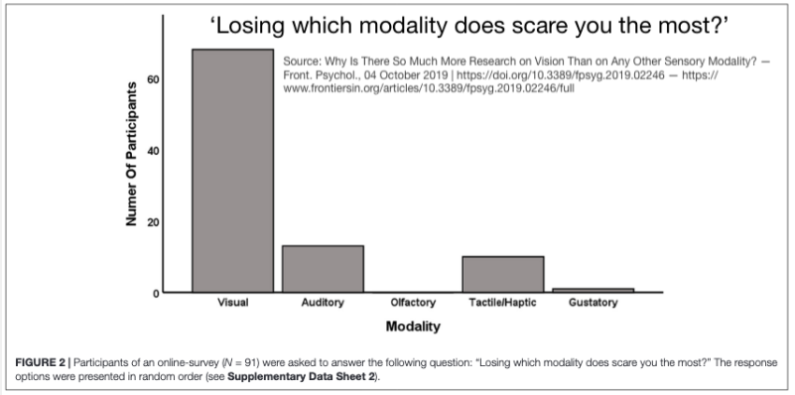
Sight and sound are far simpler senses than smell and taste

Slide 28
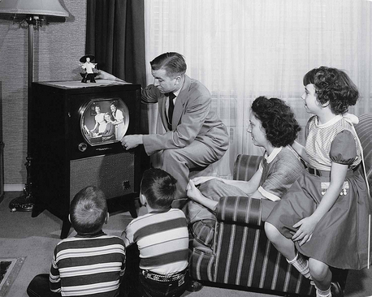
Sight and sound can be shared in real time
Barring psychological or neurological issues, people who view the exact same same audiovisual experience at the same time can agree that they experienced the same thing and can compare apples & apples.
Even if not viewed at the same time, they can agree they saw and heard the same thing and have a shared experience that can be discussed.
Property of Revolution Algorithms - Copyright 2021

Slide 29
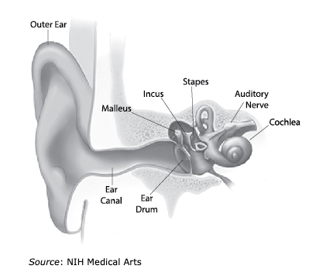
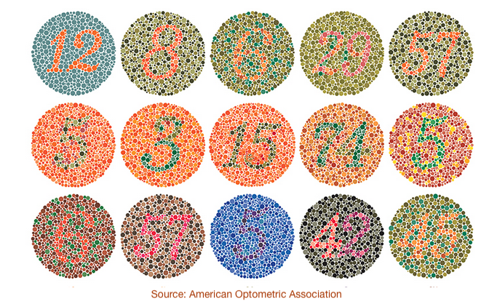
Standard tests for vision & hearing indicate a relatively narrow range of normal experience
Property of Revolution Algorithms - Copyright 2021

Slide 30
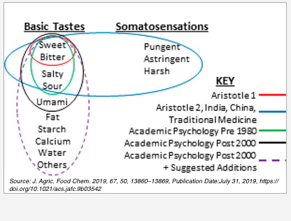
Taste is relatively simple
Scientists and philosophers have long debated what sensations qualify as “basic” tastes. Current scientific work indicates that human basic tastes may actually number six with fat now considered as a 2015 addition to the original five. (See: Oleogustus: The Unique Taste of Fat)
Bitter
Sweet
Sour
Salty
Umami
Fat
Tastes are processed by three main types of receptors and variations.
It’s important to note that scientific study of taste receptors lags behind that of smell and still has many unanswered questions.
Some sources estimate that taste is controlled by fewer than 100 genes.
Property of Revolution Algorithms - Copyright 2021

Slide 31
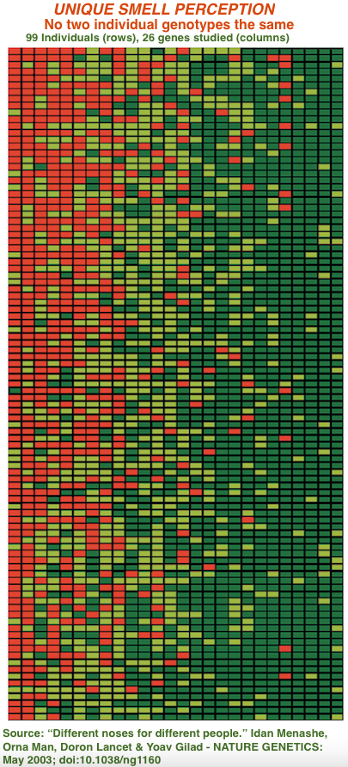
Smell is the foundation of flavor. But almost nobody has the same set of olfactory genes. Therefore, nobody smells the same thing the same way

Slide 32
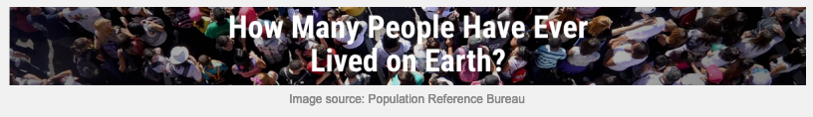
There are 400 types of olfactory receptors, and the scientific research so far indicates that no two people are likely to have the same exact set. That means that there are approximately 4.71²³⁸ possible combinations of olfactory receptors.
Looked at another way, there are 4.71 Trillion, Trillion, Trillion, Trillion, Trillion, Trillion, Trillion, Trillion, Trillion, Trillion ,Trillion, Trillion, Trillion, Trillion, Trillion, Trillion, Trillion, Trillion, Trillion, Trillion, Trillion, Trillion, Trillion, Trillion, Trillion, Trillion individual ways of smelling.
That number far exceeds the approximately 110 billion people who have ever lived on earth as estimated by the Population Reference Bureau
Property of Revolution Algorithms - Copyright 2021

Slide 33
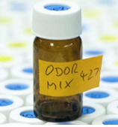
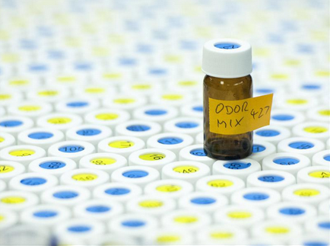
The Human Nose Can Detect a Trillion Smells: Science
But humans don’t have a trillion words to describe scents.
This is a problem for people (like wine critics) trying to describe olfactory sensations to other people given the fact that the average vocabulary is 20,000 to 35,000 words.
But that wouldn’t matter anyway because no one tastes the same wine the same way as the critic.
Property of Revolution Algorithms - Copyright 2021

Slide 34
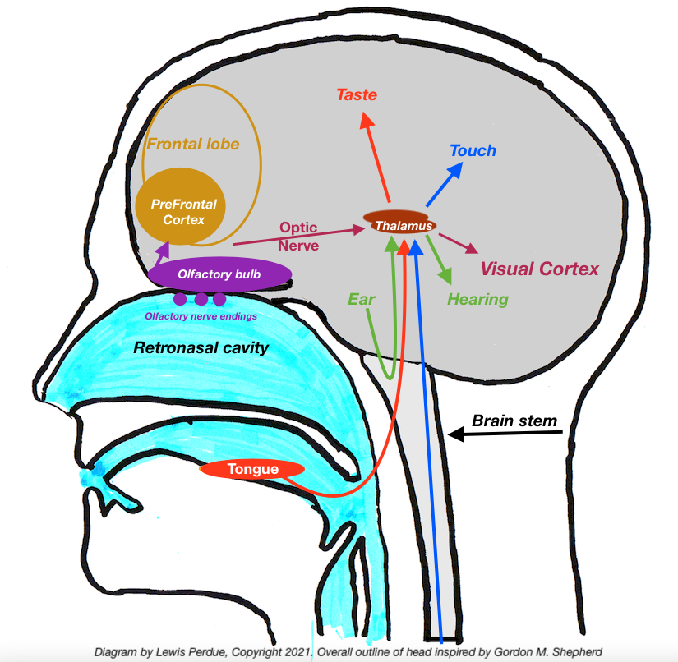
Flavors go off the rails in the brain
The radical way your brain processes smells makes describing them and creating recommendations from them almost impossible.
Olfactory signals occupy an extremely high brain priority level that surpass all other senses in its speed and direct priority access to the PreFrontal Cortex –– the center of human thought and perception.
In First Class Seating: Olfactory by itself. All Others in Tourist
While taste, vision, hearing, and touch nerve impulses all travel first to the brain stem and then to the thalamus, olfactory signals skip that connection and take a privileged express route to the highest levels of brain function that makes each of us who we are as individuals and as human beings.
Everybody But Odors Must Detour To The Thalamus For a Delay And Directions
The thalamus is a two-lobed brain structure about 5.7 centimeters long, located above the brain stem. It evaluates, sorts and routes signals to the appropriate sensory parts of the brain which further processes each type of sensory data (except olfactory).
Property of Revolution Algorithms - Copyright 2021

Slide 35
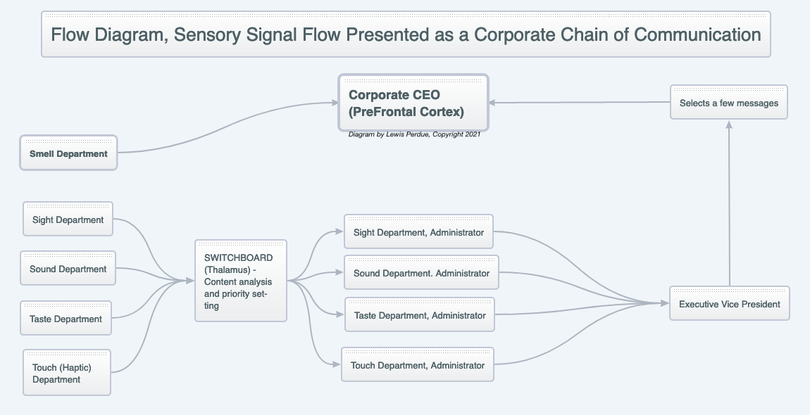
Look at this in a more familiar way: A corporate hierarchy
Property of Revolution Algorithms - Copyright 2021

Slide 36
What Makes the PreFrontal Cortex So Important?
Understanding the enormous importance of the PFC shows just how elevated and privileged the olfactory sense is.
Among the numerous vital functions performed by the PFC are:
voluntary movements (deciding how and when to move),
sequencing of complex or multi-step movements, such as getting dressed or making a cup of tea,
speech and language production in the dominant frontal lobe (opposite your dominant hand),
attention and concentration,
working memory, which involves processing recently acquired information
reasoning and judgment,
organization and planning,
problem-solving,
regulation of emotions and mood, including reading the emotions of others
personality expression,
motivation, including evaluating rewards, pleasure, and happiness,
impulse control,
controlling social behaviors. Property of Revolution Algorithms - Copyright 2021
Property of Revolution Algorithms - Copyright 2021

Slide 37
What does this have to do with why it’s so hard describing scents and using those words in reviews and for recommendations? – Part 1
Sniff and survive
The olfactory neurons with their naked tails wagging in the back of your throat, may be the adapted progeny of some ancestral organisms. One factor supporting this is the presence of odor aversions that don’t have to be learned, but are already built into the PFCs of newborn babies.
Neither adults or newborns need to learn that mercaptan (added to natural gas for safety reasons) stinks. The same goes for many other scents such as those those from sewage and decomposing flesh.
This may account for why olfactory neurons get privileged access to your PFC which can quickly activate critical thinking, memory, decision making, and threat analysis. The faster these can be assessed and reacted to, the better the chances of survival.
But more than for survival, the olfactory sense’s preferential access to the PFC offers the ability to assess a trillion odors, and differentiate them at a very deep psychological and emotional level concerning people, food, physical environments and more.
The PFC connects scents with memories regardless of whether they are pleasurable, stinky, harmless or deadly. Sometimes scents recall memories and vice versa that can be consciously connected. But odor/emotion associations may simply recall emotions — good or bad — that could influence an opinion about wine.
What’s more, some smells are subconsciously perceived. They are odors that can’t have a name, but they have their own real effects on perception and behavior, choices, preferences and and aversions.
Property of Revolution Algorithms - Copyright 2021

Slide 38
What does this have to do with why it’s so hard describing scents and using those words in reviews and for recommendations? – Part 2
A gut feeling
A “gut feeling” may be a reaction to scents (conscious and/or subconscious) detected and forwarded to the PFC so it can tap into memories and other information that create a physiological reaction.
This is an area that leads wine into the “big question” at the intersection of neurobiology and philosophy: where does consciousness come from?
No one knows. Chances are no one ever will. Theories and gargantuan debates abound, but they evade rigorous study.
However research indicates that the PFC, thalamus, amygdala, hippocampus, and other regions in the brain are involved with consciousness and perception, but how and why no one really knows.
Digging Deeper Into Consciousness
In the event that digging into the olfactory sense’s special treatment in the brain, you can always see how quickly it is to get lost in consciousness.
Property of Revolution Algorithms - Copyright 2021

Slide 39
Vision and hearing offer the ability to verbally communicate shared perceptions. (A Netflix advantage)
While there is no way to determine if each person has the same internal conscious experience, those in a movie theater, or who watch the same video with friends/family in the same place at the same time. Nevertheless share a common experience — seeing and hearing the same images and hearing the same words and sounds.
There’s common agreement among viewers watching the same video at the same time, that actor #1 said the same words, that she jumped out of the same castle window and landed in the same moat filled with alligators
Viewers don’t have to agree on whether they liked the scene, or the movie, but there’s no doubt that their ears and eyes senses experienced the same thing.
Imagine, however, that — like a movie reviewer — you have written an accurate and detailed review of a movie. The reader of that review will interpret your words according to their own life experience, education and sensory history.
That means those readers will also have no perception of the music, body language, the specific scenery, the energy, and raw emotion among the characters or their expressions and tones of voices that convey more than mere words possibly could.
Property of Revolution Algorithms - Copyright 2021

Slide 40
Wine: Stuck with the irrelevance of words
The fact that movie-goers experience the same sound and visual perceptions of a film and feel emotions at the same time develop more complete perceptions that — while not identical among all individuals — creates the possibility of a shared understanding. Which can be expressed in words.
Taste of course is fairly easy to communicate given the small number of basic tastes -- six.
Not so with smells (millions upon millions) that far exceed human vocabularies?
Furthermore, scientific research shows that most people cannot name more than two or three odors in a mixture. Those who can do that are exceptional, just making it up, guessing, or showing off.
Current wine rating, review, and recommendation systems suffer from a fatal irrelevance because flavor (taste + smell) perceptions are completely internal consciousness experiences, and — unlike sight and sound — cannot be shared directly with other people.
As a result, flavor experiences must use words to describe the sensations. Unfortunately, words are enemies of understanding when it comes to describing flavor.
Words can mean different things to different people. What does “complex” mean? Or “balanced?” “Big?” “Olive-tinged black currant?”
Property of Revolution Algorithms - Copyright 2021

Slide 41
“I really draw the line at scorched earth and spicy earth.” “First, I have never eaten earth (although I have smelled earth after a good summer rain) and I have never been near scorched earth, perhaps because Attila the Hun and Genghis Khan were a bit before my time. “And how do you know what spicy earth tastes or smells like? I could go into my back yard and sprinkle some cumin, cardamom, turmeric and fenugreek; but how would I know that those are the right choices, rather than coriander, chili powder, caraway seeds and cayenne?” — From On Wine Bullshit, Journal of Wine Economics, Volume 2, Number 2, Fall 2007, Pages 129–135

Slide 42
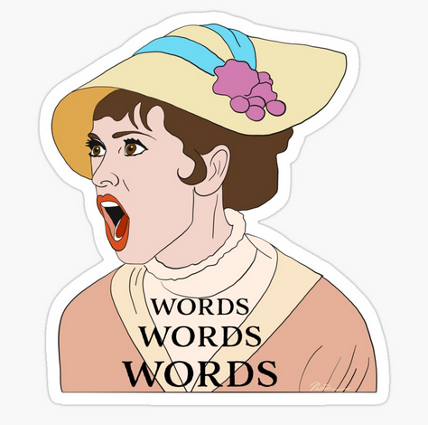
Words! Words! I'm so sick of words!
I get words all day through;
First from him, now from you!
Is that all you blighters can do?
Don't talk of stars Burning above;
If you're in love, Show me!
-- My Fair Lady: Book and lyrics by Alan Jay Lerner.

Slide 43

ORANGE!
We are all Alice
Life experience shapes our tastes, and especially as to how we perceive them.
Perhaps someone says they detect notes of orange.
Are they thinking Mandarin, Navel, Blood, Valencia, Jaffa, or another of the hundreds of types of oranges? All have subtle differences, and the memory of the flavor is inextricably linked with previous experience.
Individual perception exists in the individual brain and is inaccessible beyond the individual skull. As a result, there is no way to determine if two people are talking about the same perception.
While that one flavor may exist in the same perception neighborhood in two people, there is no guarantee that two people will be in the same neighborhood after sampling a simultaneous sip of the hundreds of flavor compounds found in wine.
Substitute any other flavor for orange and the same situation exists … multiplied by all of wine’s flavors.
“I don’t know what you mean by ‘glory,’ ” Alice said.
Humpty Dumpty smiled contemptuously. “Of course you don’t—till I tell you. I meant ‘there’s a nice knock-down argument for you!’ ”
“But ‘glory’ doesn’t mean ‘a nice knock-down argument’,” Alice objected.
“When I use a word,” Humpty Dumpty said, in rather a scornful tone, “it means just what I choose it to mean—neither more nor less.”
“The question is,” said Alice, “whether you can make words mean so many different things.”
“The question is,” said Humpty Dumpty, “which is to be master—that’s all.”
— From Lewis Carroll’s Through the Looking-Glass
Property of Revolution Algorithms - Copyright 2021

Slide 44
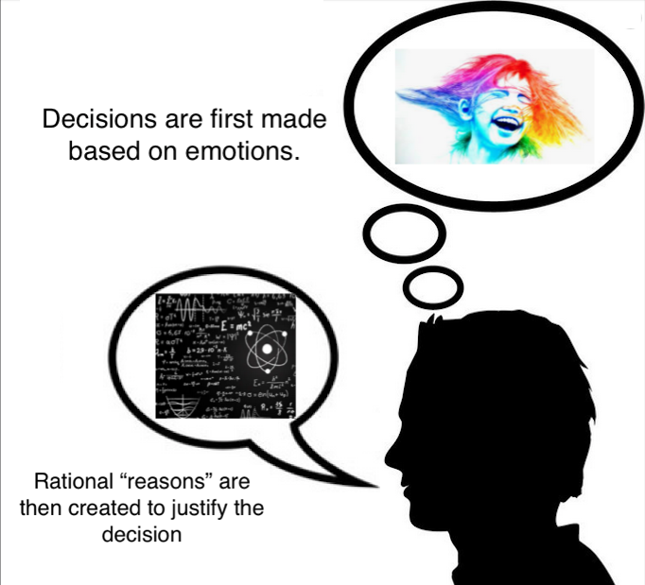
Neuroscience Confirms We Buy on Emotion & Justify with Logic & Yet We Sell to Mr. Rational & Ignore Mr. Intuitive
How Emotion Drives Brand Choices And Decisions
Mass-Scale Emotionality Reveals Human Behaviour and Marketplace Success
Rationality and emotions
Property of Revolution Algorithms - Copyright 2021

Slide 45
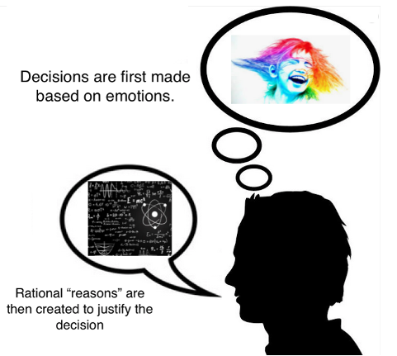
Because emotions and the subconscious are fundamental drivers of purchase decisions, Clans is vital even for “metric-driven” products.
People believe (and want to believe) that they make decisions based on rational metrics. That’s false.
Property of Revolution Algorithms - Copyright 2021

Slide 46
How does Clans navigate this thicket?
Tested and validated a working, patent-pending recommendation system able to capture perception, and intent with an accuracy rate of 72-93% using normalized third-party data (As opposed to Clans Native Data).
Proprietary Clans native data format expects consistently accurate recommendations of 90%+
Sentiment analysis system and subconscious data capture will allow finer, more accurate targeting of recommendations.
Requires NO VIOLATION of personal privacy.
Property of Revolution Algorithms - Copyright 2021
Property of Revolution Algorithms - Copyright 2021

Slide 47
Much more data and information can be found at this series of articles written by Clans Founder Lewis Perdue
Article #1: How A Netflix-Style Recommender Is Vital to Reversing Wine’s Market Marginalization
Article #2: Why solving the “Paradox of Choice” is a major reason Netflix’s recommender is worth $1 Bil/yr. And why wine fails at that.
Article #3: Reviews and 5-Star ratings are so useless for recommendations that Netflix ditched its prized $1-million algorithm.
Article #4: Wine wreck-commendations: Genes determine that no two people taste the same wine the same way.
Article #5: Netflix Added Big Data To Amp Up Recommendations. Why Wine Needs a Touch of That Too.
Article #6: The Path To Netflix-Quality Wine Recommendations Leads Through The Doors of Perception
Copyright 2021, Wine Industry Insight

